Slide 1






Slide 2
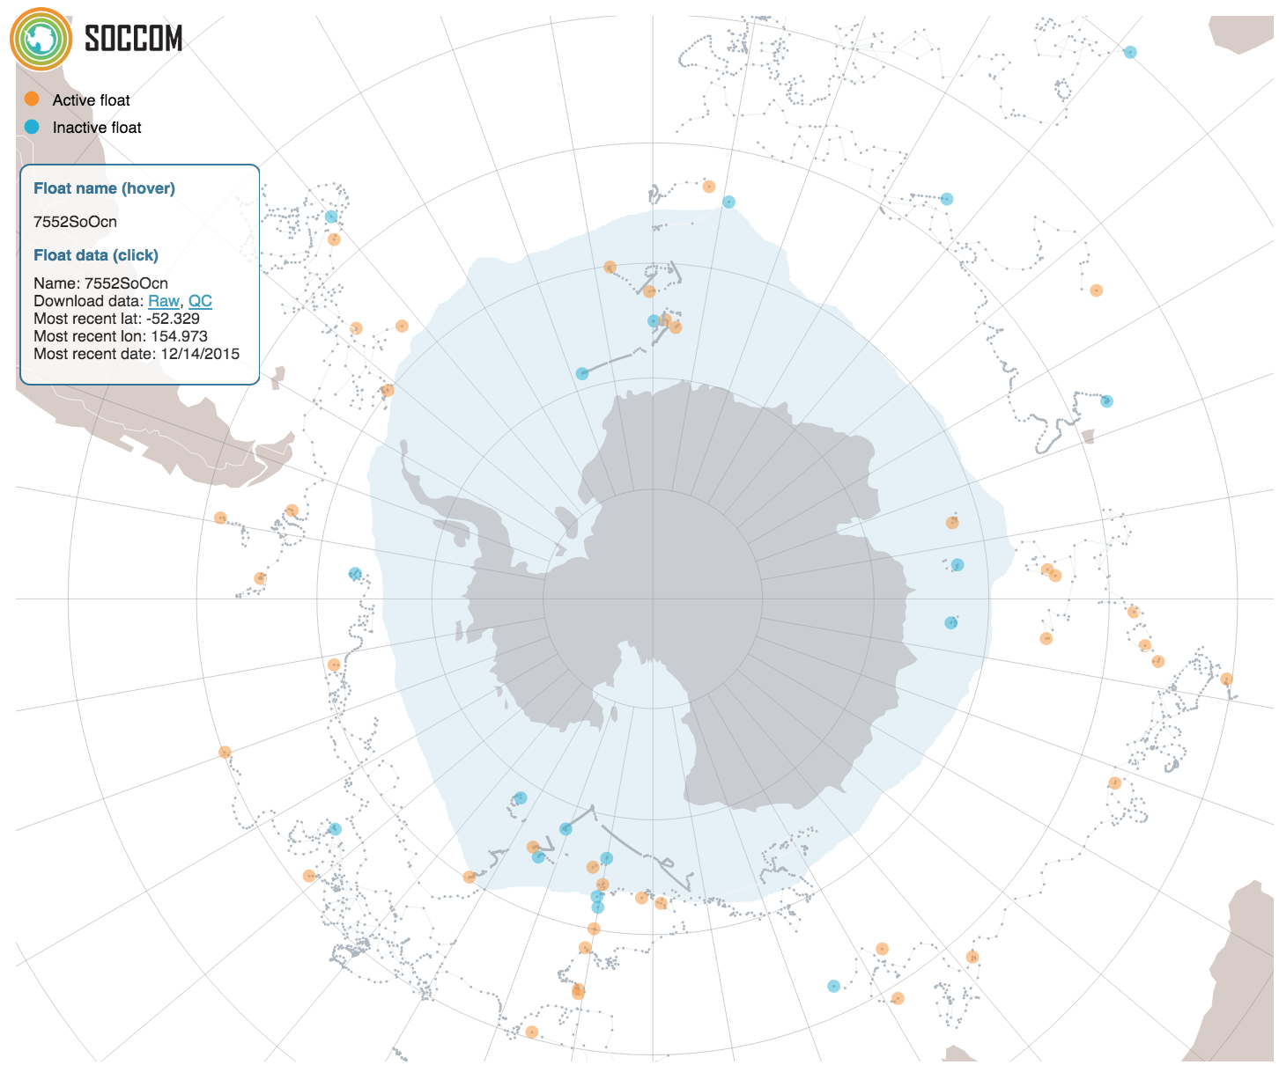

Using SOCCOM Viz Visualizing Data of the Southern Ocean
June 2016 Climate Central
Notes:
title page
Using SOCCOM Viz
Visualizing Data of the Southern Ocean
June 2016
Climate Central SOCCOM
Maybe add a picture of the data?

Slide 3
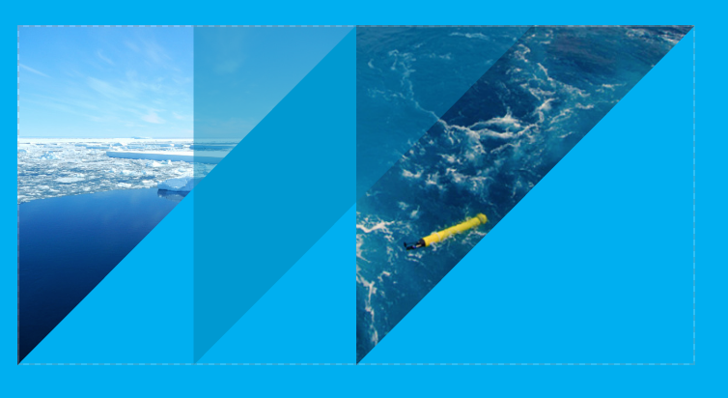
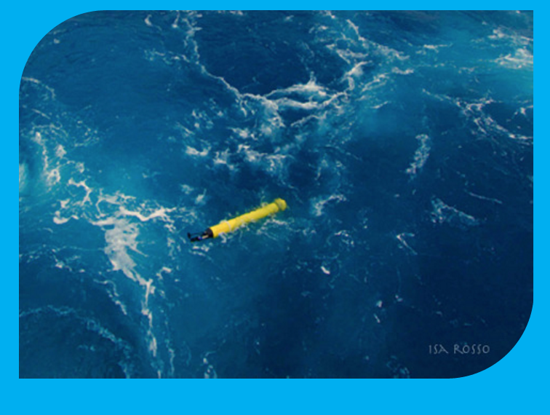
Creating the Plot
Plot v Text file
Use a text file to import into a different
Raw data v. adjusted
Data Quality
What dates?
Float options
Make sure the float(s) you choose have the correct sensors you are looking for!
X Y choices
Autoscale
Y stack
ON: Show multiple plots
OFF: Overlay multiple floats’ data on one plot
http://soccom.princeton.edu/soccomviz.php
Notes:
how to
Go through the parameters/ good hints
data stack v no data stack (add examples)
http://soccom.princeton.edu/soccomviz.php
Plot v text file
Raw data v adjusted
adjusts for uncertainties and mechanical errors
Data quality
using all the data or only the best fitting
What dates?
use if you want to track a specific year or time period
Float options
make sure the float(s) chosen have the data you are looking for
XY choices
create projections of data you want
Autoscale
Y stack
multiple graphs or one graph

Slide 4
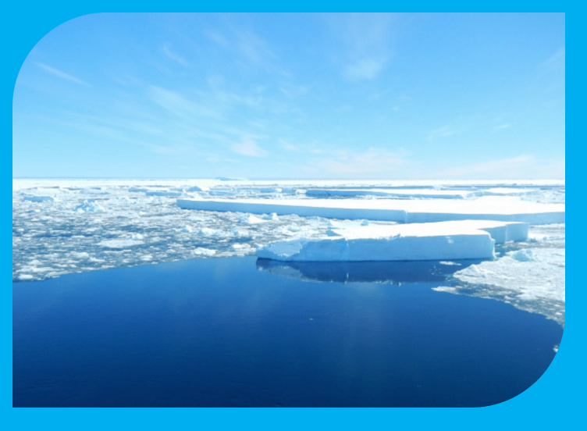
Biogeochemistry: Why Do We Care?
Climate Change
The Southern Ocean absorbs most of the world’s produced CO₂
Notes:
Carbon sink: absorbs most of the world’s CO2
Explains the world around us
Check with already made pdf

Slide 5
How to Use Data Viz
If you want…
Seawater Properties
Temperature (°C)
Density anomaly
The density of the seawater
pH in situ (Total)
Calculated from current water temperature
pH 25°C (Total)
Seawater concentration data
Nitrate (μM)
Salinity
Oxygen (μM)
The concentration of oxygen
Oxygen Saturation (%)
Organic Matter
Chlorophyll (μg/l)
Back scatter (/m/sr)
CDOM (ppb)
Chromophoric Dissolved Organic Matter
Use with:
Depth (m)
Date
Longitude (°E)
Latitude (°N)
Notes:
How to
More good tips and chart of what to use when you need
If you want…
Seawater concentration data
Nitrate
Salinity
Oxygen
OxygenSat
Plant Matter
Chlorophyll
Back scatter
CDOM
Properties
temperature
density
pH in situ
pH 25 C
Visualize with
depth
date
longitude/ latitude
* multiple parameters (example salinity v density)

Slide 6
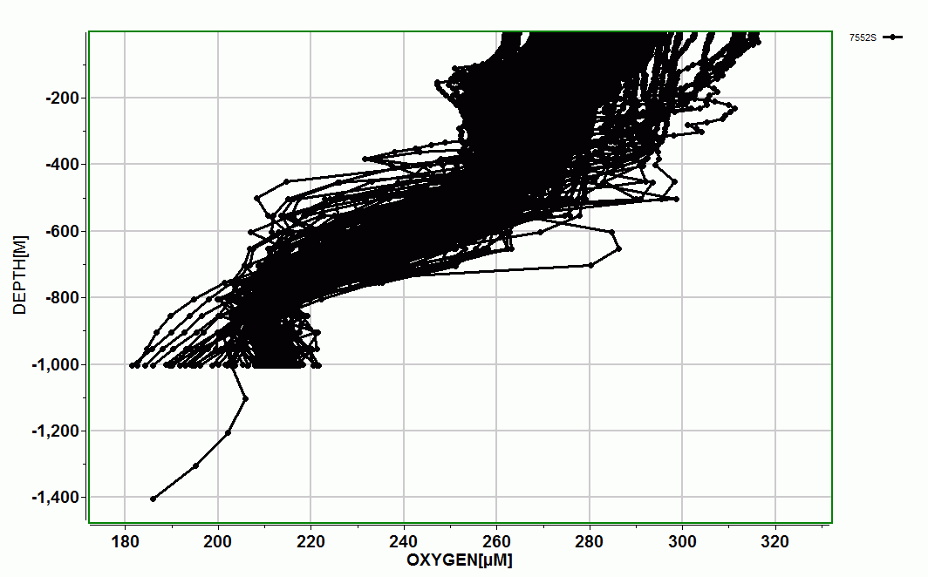
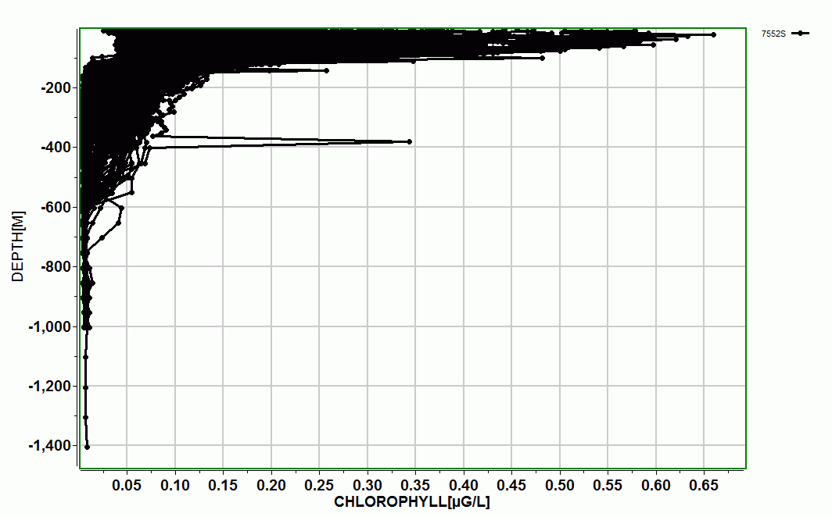
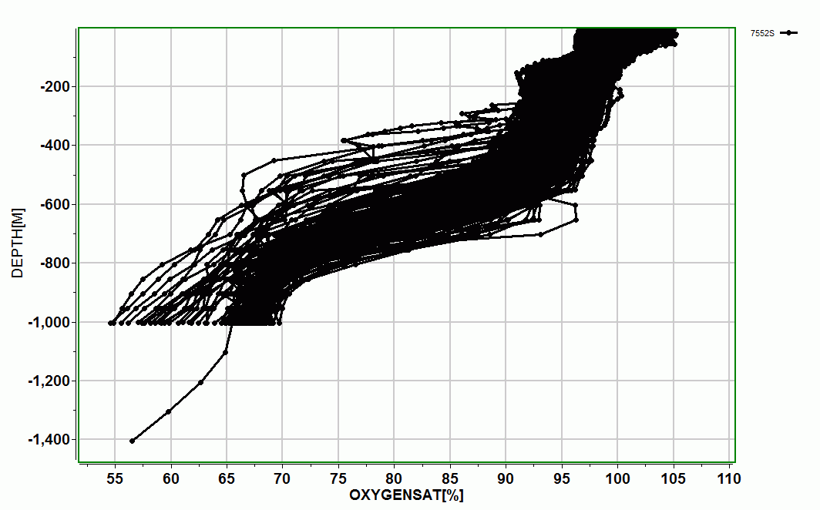
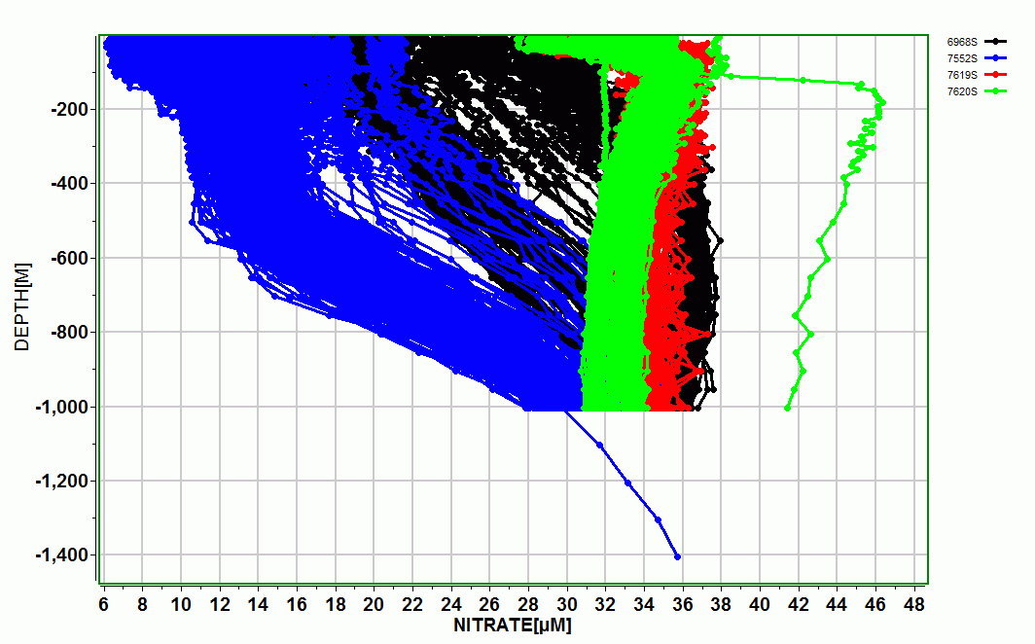
Depth Analysis
Oxygen Concentration v Depth
Chlorophyll v Depth
Oxygen Saturation v Depth
Nitrate v Depth
Notes:
Depth:
Add the graphs
Tips
use depth on the y axis
What is biogeochemistry and what does it tell us why do we care?
Depth graphs:
Examples of nitrate, temp, chlorophyll, oxygen
Temperature at increasing depths
Oxygen at increasing depth
Nitrate levels at increasing depth
Chlorophyll levels at increasing depth

Slide 7
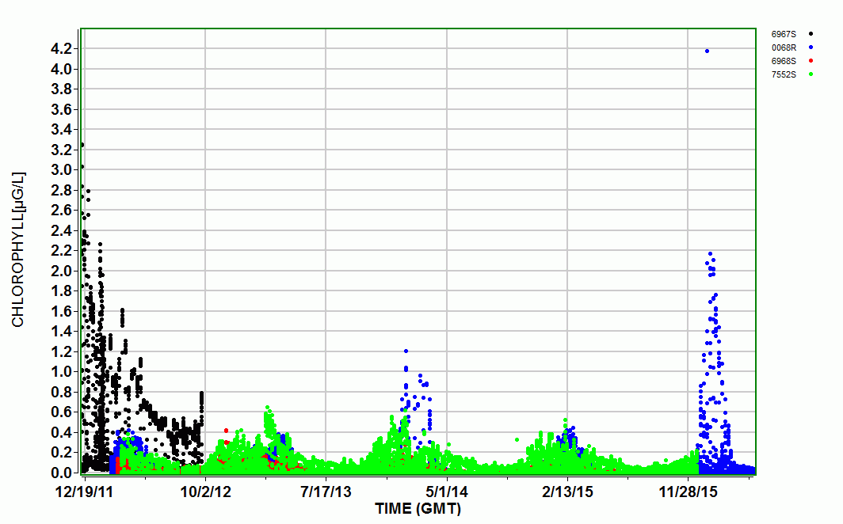
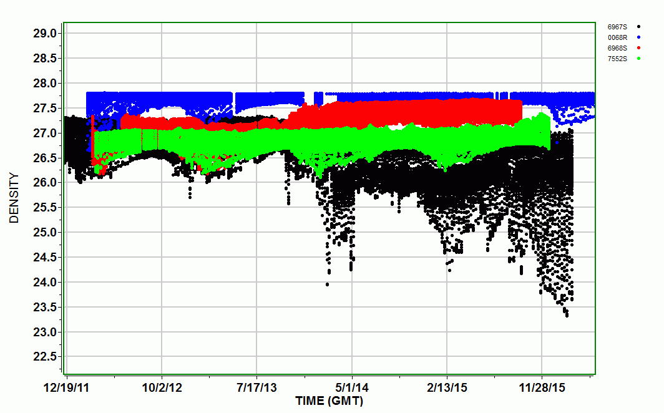
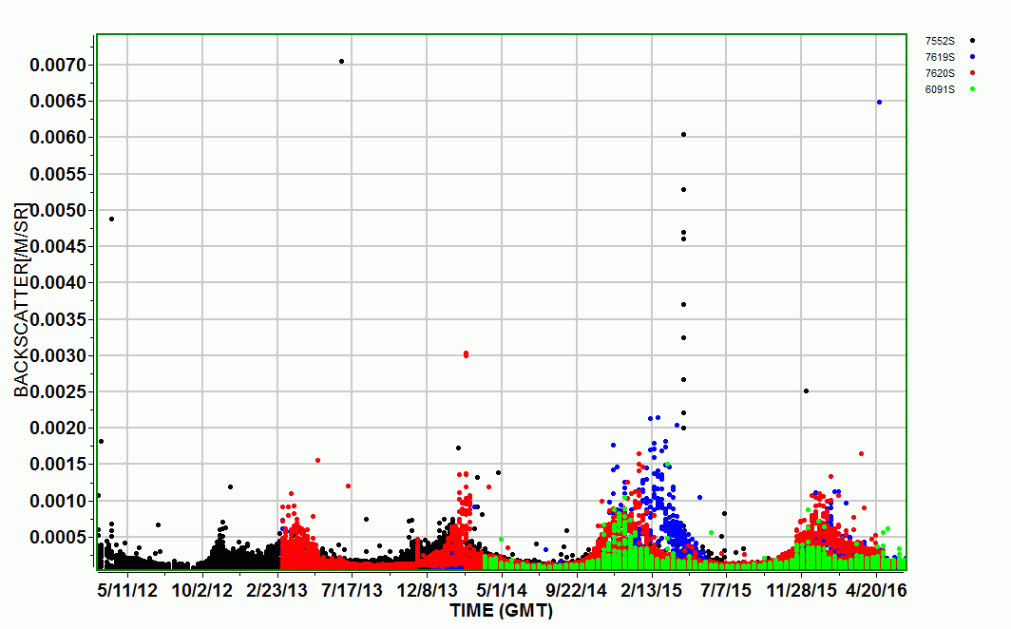
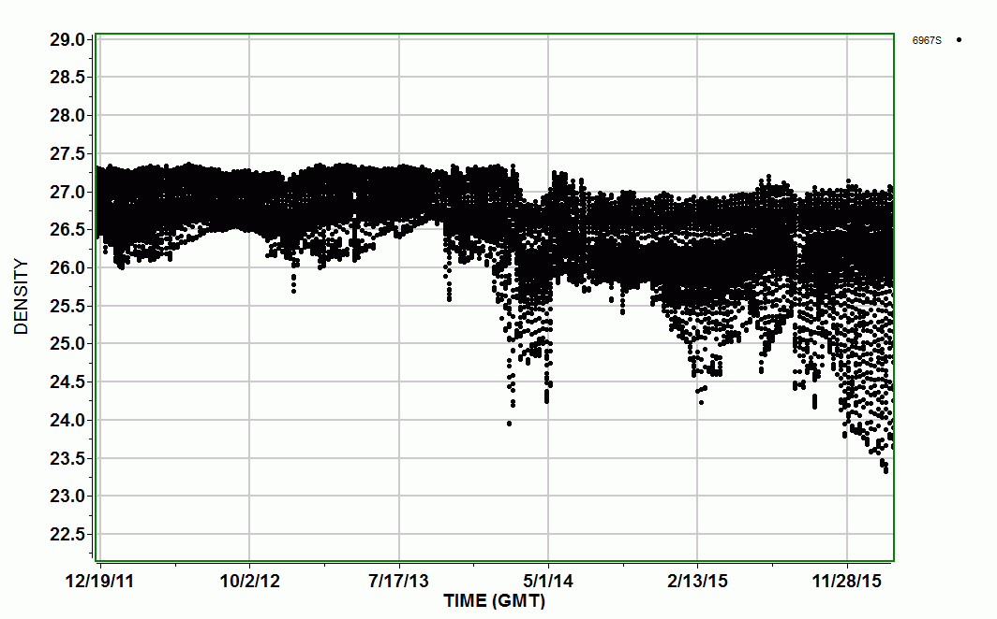
Time Analysis
Chlorophyll Over Time
Density Over Time (4 Floats)
Backscatter Over Time
Density Over Time (1 Float)
Notes:
Date
add the graphs
Tips
use on x axis
try doing multiple years/multiple floats
Put location of floats on the map
Date graphs
Use with density, temp, chlorophyll, backscatter
Chlorophyll Levels over time
Back Scatter over time
Density over time (2)

Slide 8
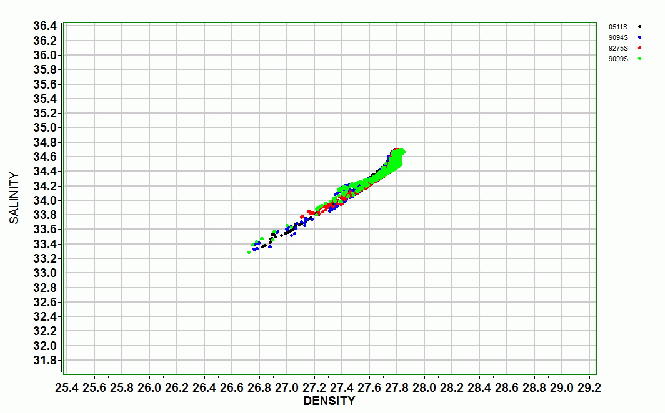
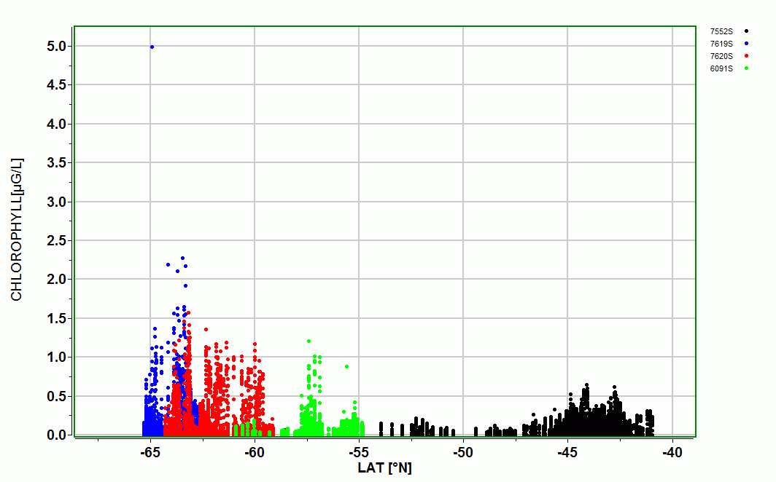
Other Plot Examples
Salinity v Density
Chlorophyll Changes with Latitude
Try plotting with latitude or longitude!
What combinations can you discover?
Notes:
Other (lon/lat/ others)
add graphs
Tips
Many more possibilities! Explore and have fun!
Reference on the back scatter and oxygen
see the email
Lon/Lat graphs (oxygen?)
Other possible correlations (density and salinity)
Salinity of Seawater at Varying Density
Chlorophyll Levels at Progressing Latitude

